Slide 1
What and how?
Microphone array technology and beamforming

Slide 2



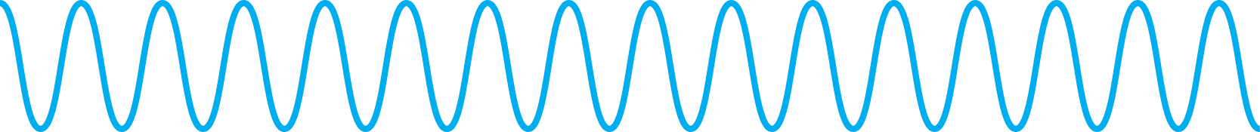

Locating sounds
Sound waves
T0
T1

Slide 3
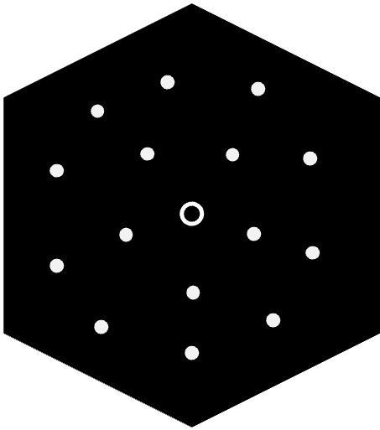
From 2 to multiple ears

Slide 4
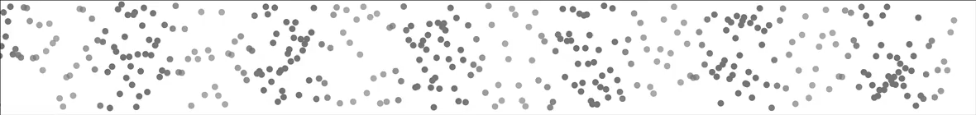
Delay and sum beamforming
Sound waves

Slide 5
Delay and sum beamforming
A
Microphone Array
Time
Delay:0
A
Time
Delay:0
SUM
A
Sound waves
Time
Delay:0
The sound waves arrive each individual microphone at different times

Slide 6
Delay and sum beamforming
A
Microphone Array
Time
Delay:1
A
Time
Delay:0
SUM
A
Sound waves
Time
Delay:0

Slide 7
Delay and sum beamforming
A
Microphone Array
Time
Delay:2
A
Time
Delay:1
SUM
A
Sound waves
Time
Delay:0

Slide 8
Delay and sum beamforming
A
Microphone Array
Time
Delay:2
A
Time
Delay:1
SUM
A
Sound waves
Time
Delay:0

Slide 9
Delay and sum beamforming
A
A
Microphone Array
Time
Delay:2
A
Time
Delay:1
SUM
A
Sound waves
Time
Delay:0

Slide 10
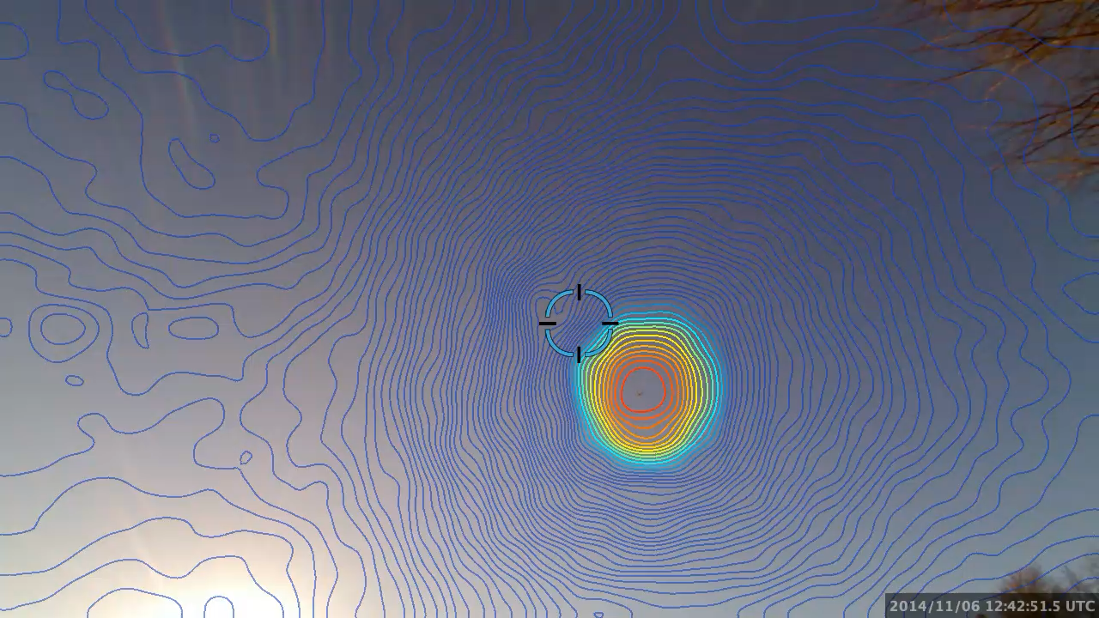

Slide 11
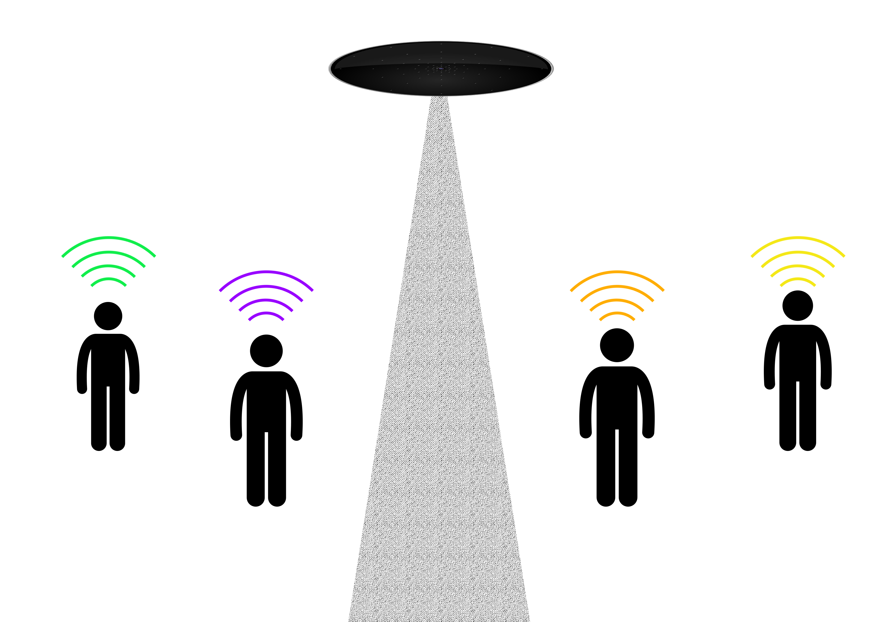
Steering a microphone array

Slide 12
Beamforming microphone array
Microphone Array

Slide 13
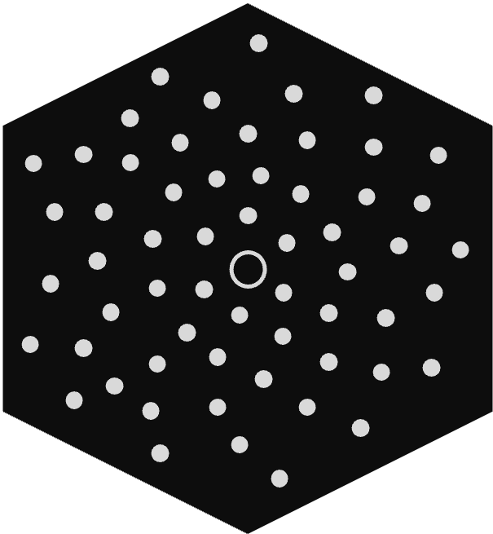
What decides the range?
?

Slide 14


Increase number of microphones
Increased sensitivity
Better Range*
*under very quiet conditions

Slide 15
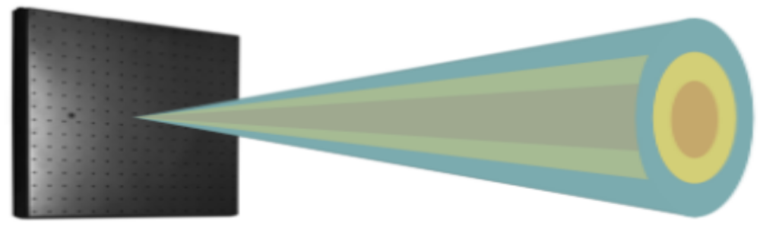

Increase array size
Larger array
Smaller focus
Better Separation

Slide 16
Summary
Microphone arrays allows you to listen in multiple directions at the same time.
Delay and sum beamforming makes it possible to listen in directions without physically moving the array.
The range of the arrays listening capabilities is hard to determine due to the number of factors affecting it.

